Slide 1
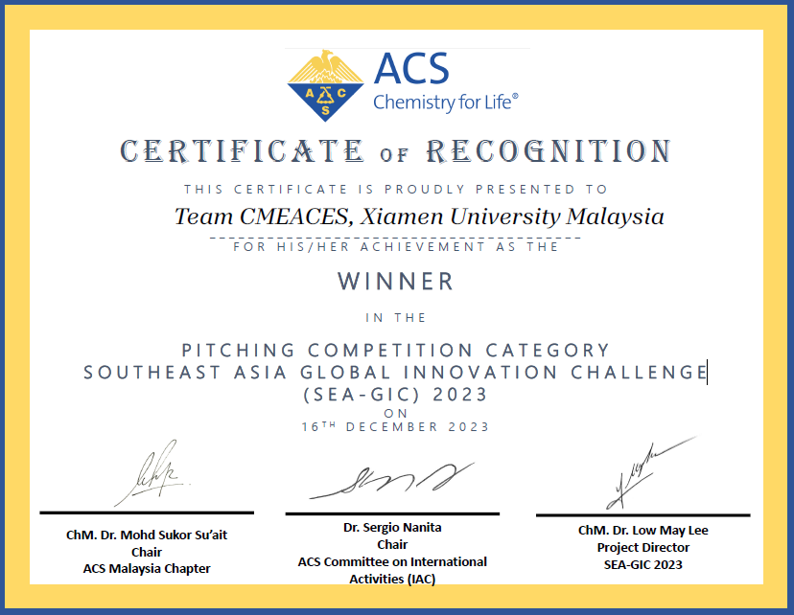
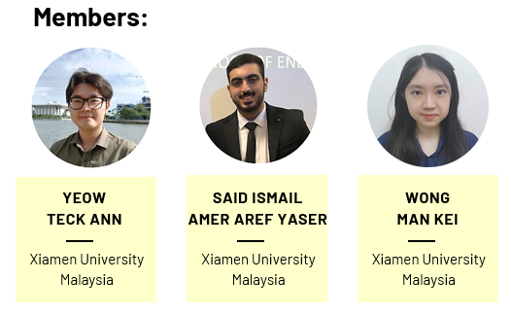
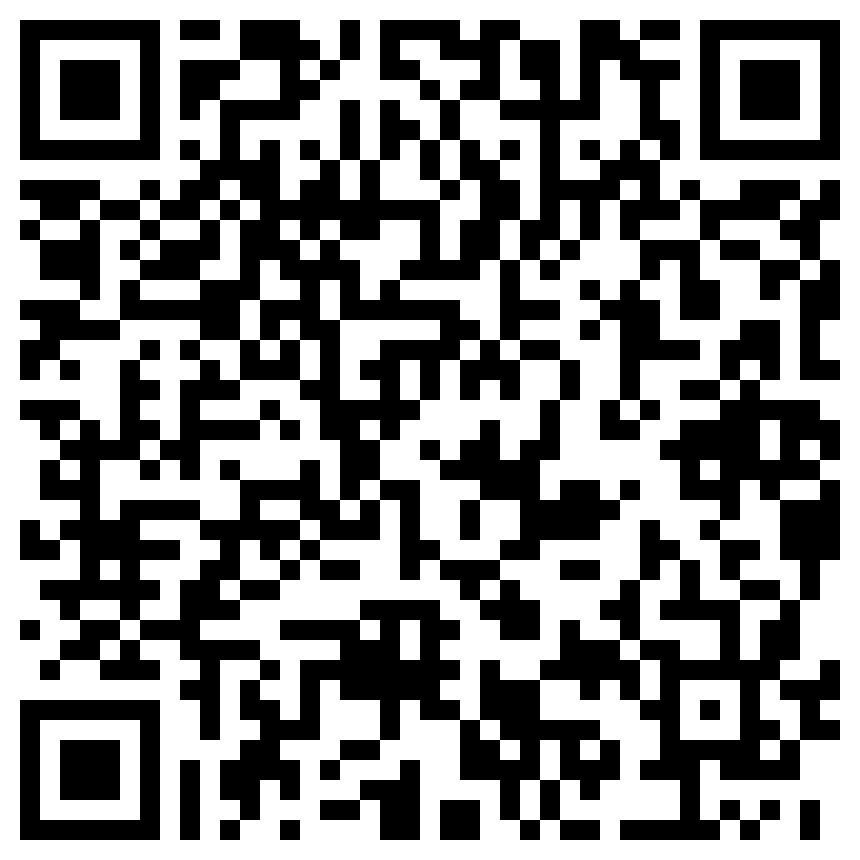
BACHELOR OF CHEMICAL ENGINEERING WITH HONOURS
[R/524/6/0063] 05/28 [MQA/FA5713] . BEM/EAD/02-75/WA/04 (002)
Winner
Official news
South East Asia Global Innovation Challenge 2023 (SEA-GIC 2023)
About the competition: SEA-GIC 2023 required participants to perform a pitching presentation and provide a solution of renewable fuel technologies. In addition to that, the participants should provide the technology innovation and advantages, market opportunity, discussion on chemistry, future requirements, and recommendations for stakeholders and decision-makers.
Recognized by
More Information
Student Chapters
Ministry of Higher Education, MOHE
(Malaysian Qualification Agency, MQA)
Board of Engineers Malaysia, BEM (Engineering Accreditation Council, EAC & Washington Accord)
Disclaimers

