Slide 1
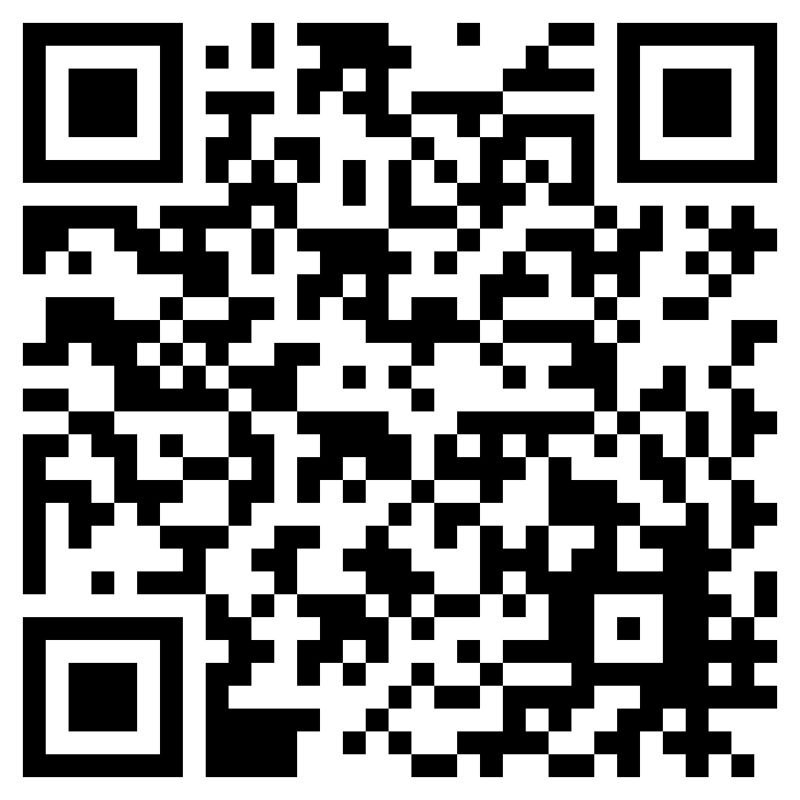
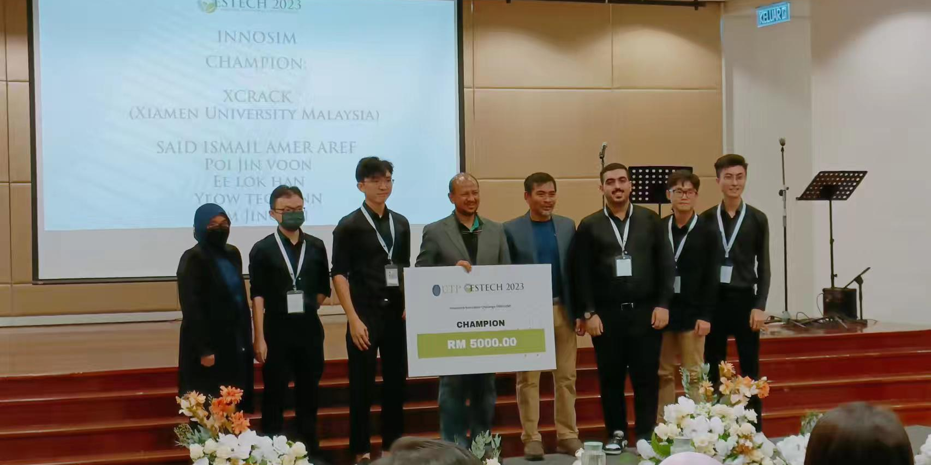
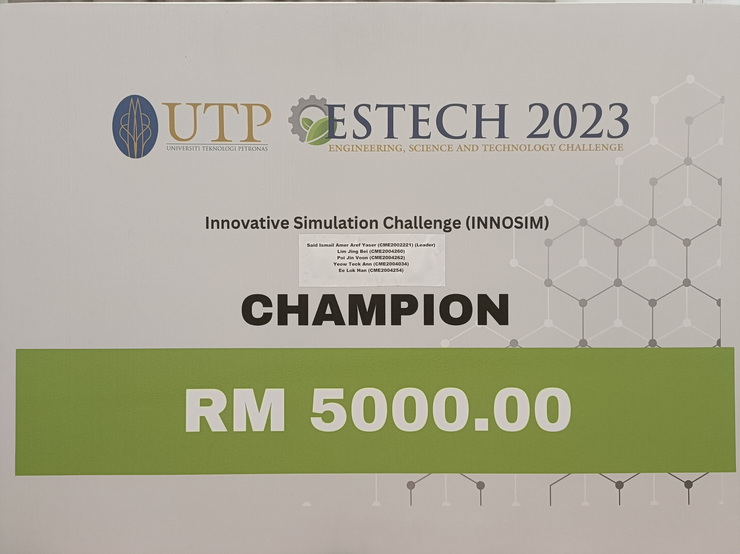
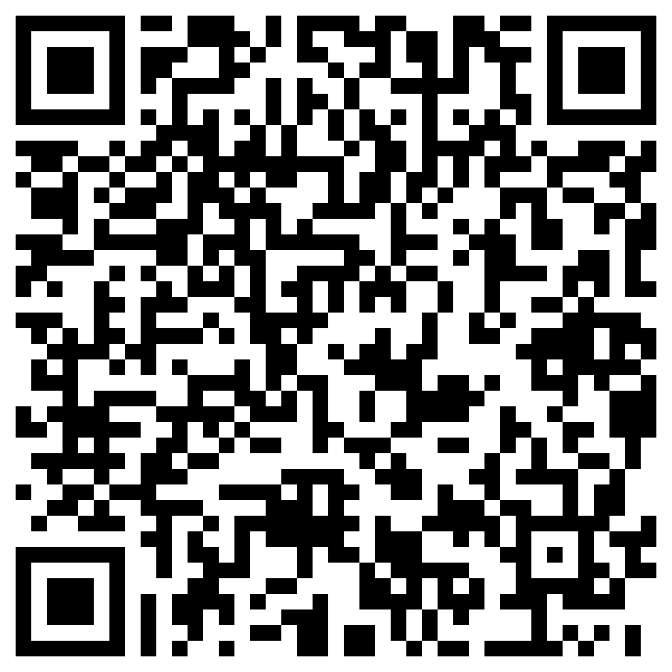
BACHELOR OF CHEMICAL ENGINEERING WITH HONOURS
[R/524/6/0063] 05/28 [MQA/FA5713] . BEM/EAD/02-75/WA/04 (002)
Champion
Innovative Simulation Challenge 2023 (INNOSIM 2023)
Engineering, Science, and Technology Challenge (ESTECH) 2023
Official news
Team XCRACK and their advisor Asst. Prof. Dr. Noraini binti Mohd received the champion's cheque from Prof. Dr Nor Hisham bin Hamid, Deputy Vice Chancellor of Student Affairs of University Technology PETRONAS (UTP)
The case study for INNOSIM 2023 is provided by Schlumberger Limited (SLB)
Team XCRACK has presented their proposal and simulations of two green production technologies which are the co-gasification of palm oil empty fruit bunches and mesocarp fibers and Sulfur-Iodine thermochemical cycle (SITC)
Team XCRACK: Ee Lok Han, Lim Jing Bei, Said Ismail Amer Aref Yaser, Yeow Teck Ann, Poi Jin Voon Supervisor: Asst. Prof. Dr. Noraini binti Mohd
Co-Supervisor: Asst. Prof. Dr. Lam Weng Hoong
Recognized by
More Information
Student Chapters
Ministry of Higher Education, MOHE
(Malaysian Qualification Agency, MQA)
Board of Engineers Malaysia, BEM (Engineering Accreditation Council, EAC & Washington Accord)
Disclaimers

